Slide 1



Humanoid Robot Control using Orbital Energy of the Variable Height Inverted Pendulum
Prof. G. Oriolo
Prof. L. Lanari
Supervisor: N. Scianca
Underactuated Robots, A.Y. 2020/2021
Leonardo Salustri (M1762556)
Paolo Sebeto (M1894763)
Francesco Scotti (M1758391)

Slide 2
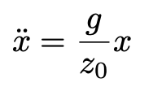
Introduction
LIP is the simplest model for bipedal walking:
All the mass of the robot is considered to be concentrated at its Center of Mass (CoM) with massless telescopic leg.
It’s not possible generate CoM height variations, as the hypothesis of constant CoM height is required to keep the model linear.
How to plan a gait introducing a variable CoM height trajectory ?
Variable height Inverted Pendulum, with Orbital Energy Control
1

Slide 3
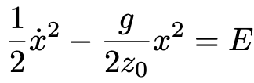
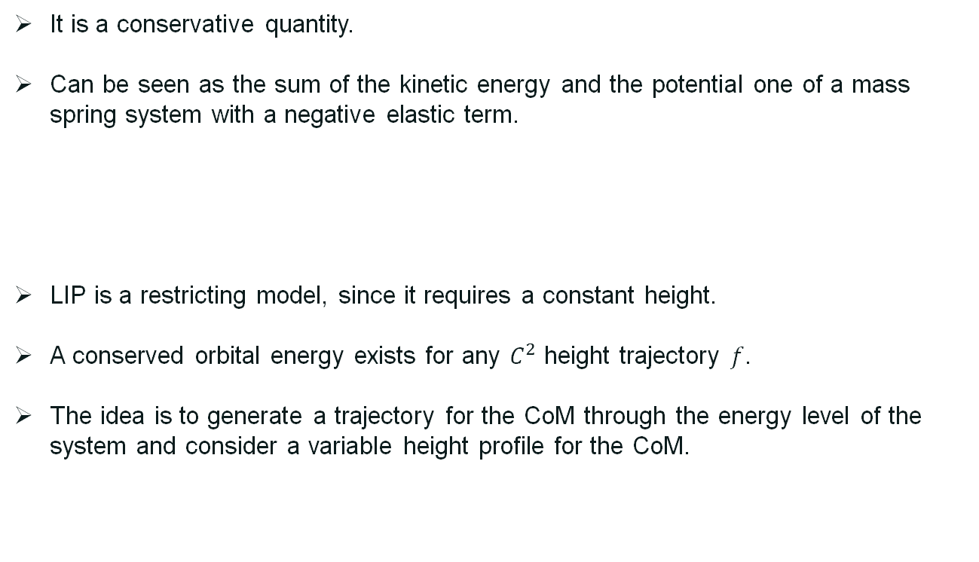
Orbital Energy
It is a conservative quantity.
Can be seen as the sum of the kinetic energy and the potential one of a mass spring system with a negative elastic term.
LIP is a restricting model, since it requires a constant height.
A conserved orbital energy exists for any $C^{2}$ height trajectory $f$.
The idea is to generate a trajectory for the CoM through the energy level of the system and consider a variable height profile for the CoM.
2

Slide 4
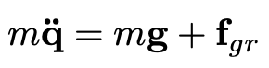
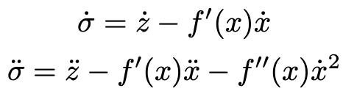
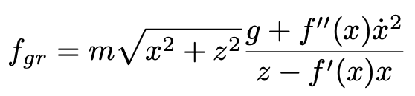
Variable Height Inverted Pendulum
Consider a 2D motion in the xz-plane.
It is assumed that the ZMP is on the foot contact point, always at the origin of the reference frame.
We want the ground reaction force to be able to mantain the virtual holonomic constraint z = f(x).
This constraint is treated as a manifold in the system’s 4-dimensional state space defined by: σ = z – f(x) = 0
with q = [x z]^{T}
3

Slide 5
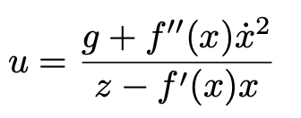
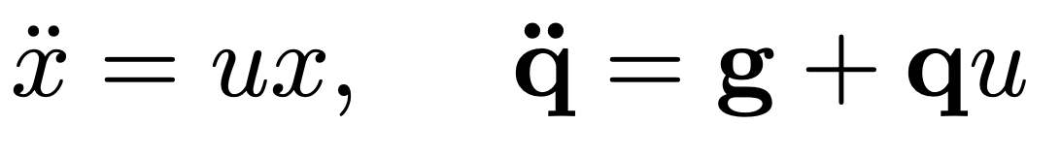
Variable Height Inverted Pendulum
Parametrizing the ground reaction force as f_{gr} = mqu where:
The unconstrained d.o.f. x and the complete dynamics are respectively:
This single control input (u ≧ 0) is used to control both horizontal and vertical CoM position.
with q = [x z]^{T}
4

Slide 6
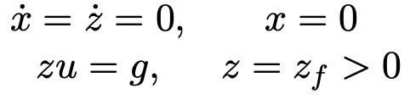
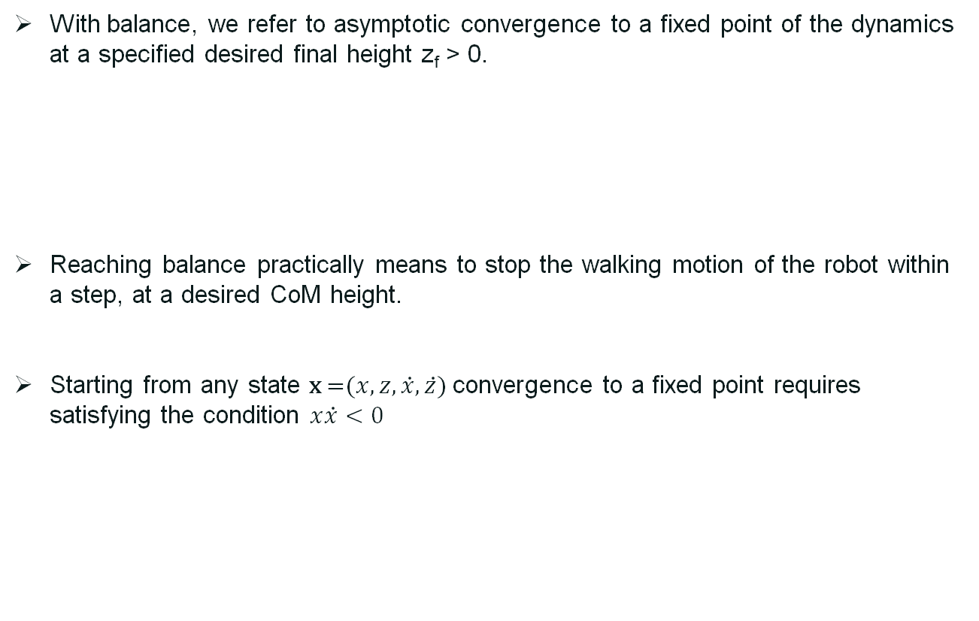
Conditions for Balance
With balance, we refer to asymptotic convergence to a fixed point of the dynamics at a specified desired final height z_{f} > 0.
Reaching balance practically means to stop the walking motion of the robot within a step, at a desired CoM height.
Starting from any state x =($x,z,\dot{x},\dot{z}$) convergence to a fixed point requires satisfying the condition $x\dot{x}<0$
5

Slide 7
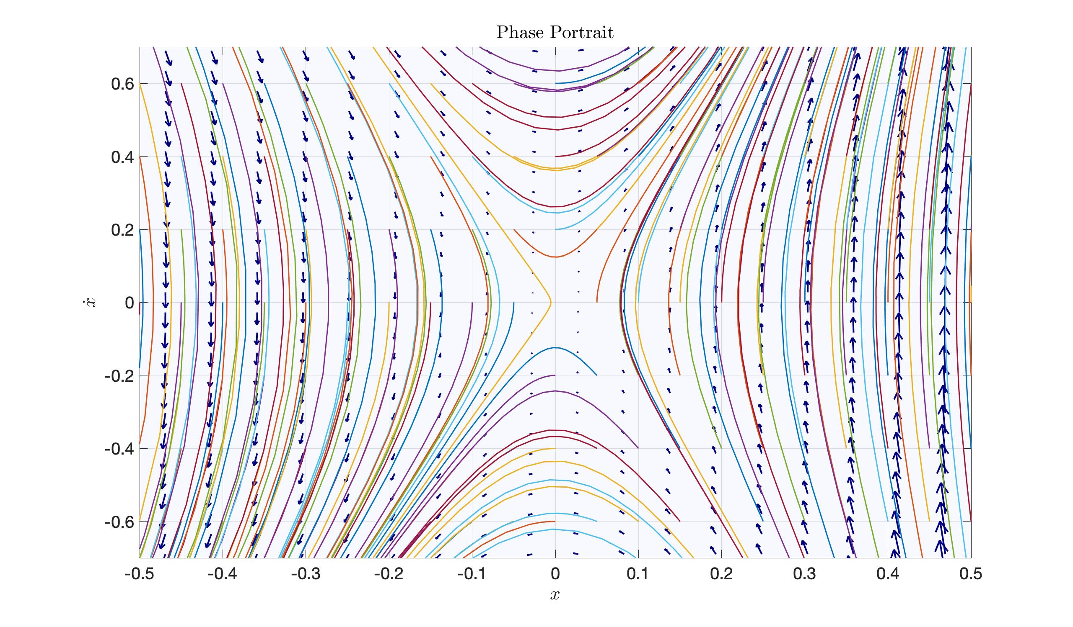
6

Slide 8
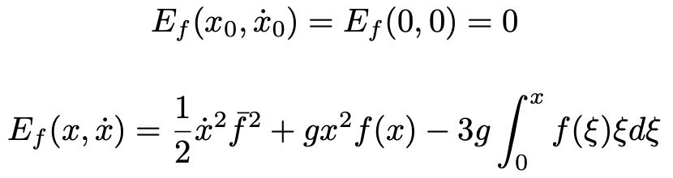
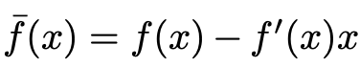

Derivation of height trajectory
First of all, given an initial state x₀ = $(x_{0},z_{0},{\dot{x}}_{0},{\dot{z}}_{0})$ we enforce the two initial conditions: $f\left(x_{0}\right)=z_{0}$ and $f^{′}\left(x_{0}\right)=\frac{{\dot{z}}_{0}}{{\dot{x}}_{0}}$
The balance conditions requires, for the Orbital energy associated to f, to satisfy:
with:
7

Slide 9
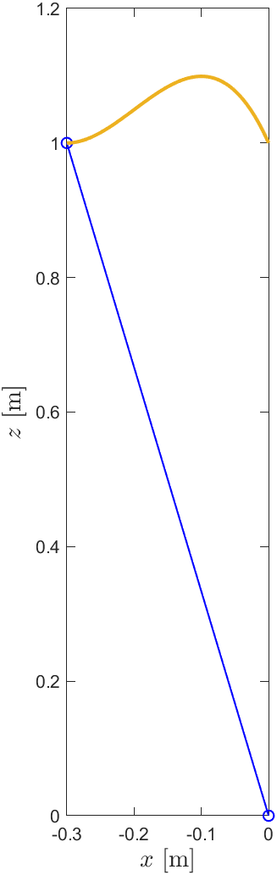
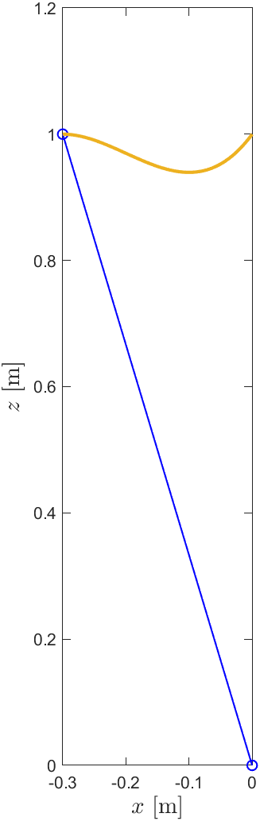
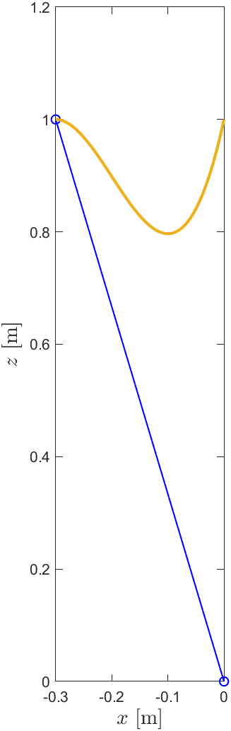
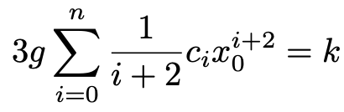
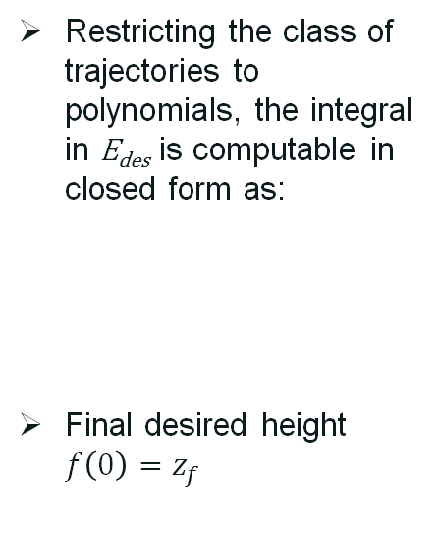
Cubic Polynomial f(x)
Restricting the class of trajectories to polynomials, the integral in E_{des} is computable in closed form as:
Final desired height $f\left(0\right)=z_{f}$
8

Slide 10
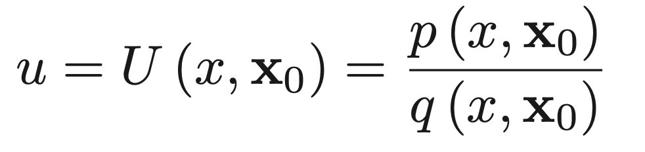
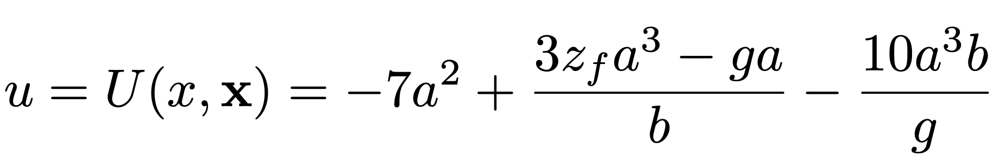
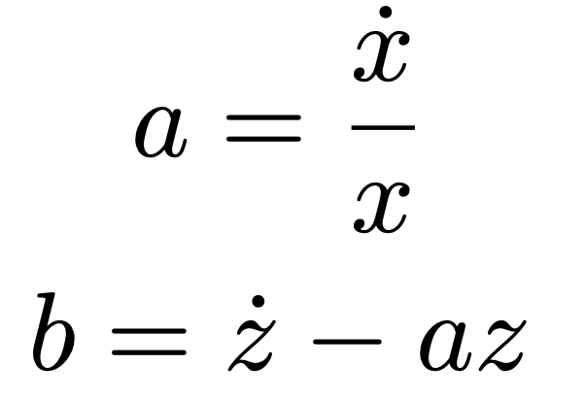
The Controller u
The general expression for the control u is:
Given f(x) as polynomial function and x, we can derive u in closed form as a rational function of x and x₀.
with:
9

Slide 11
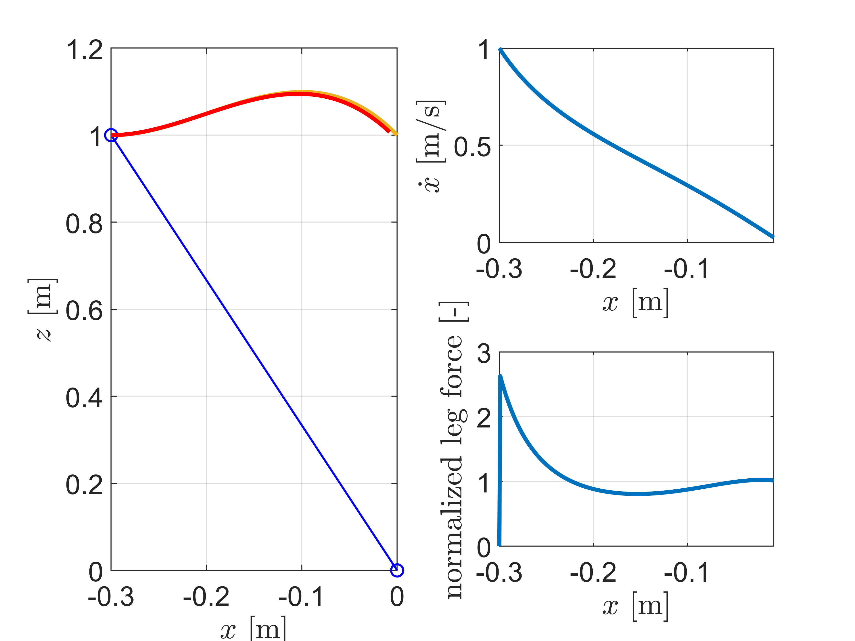
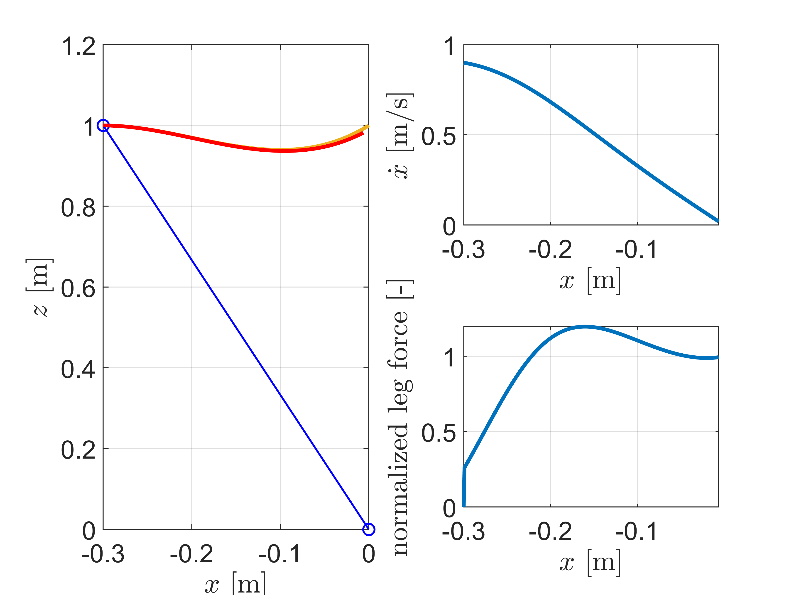
Step Simulation with the Controller u
10

Slide 12
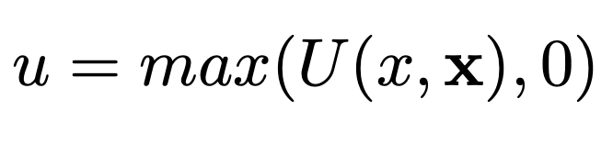
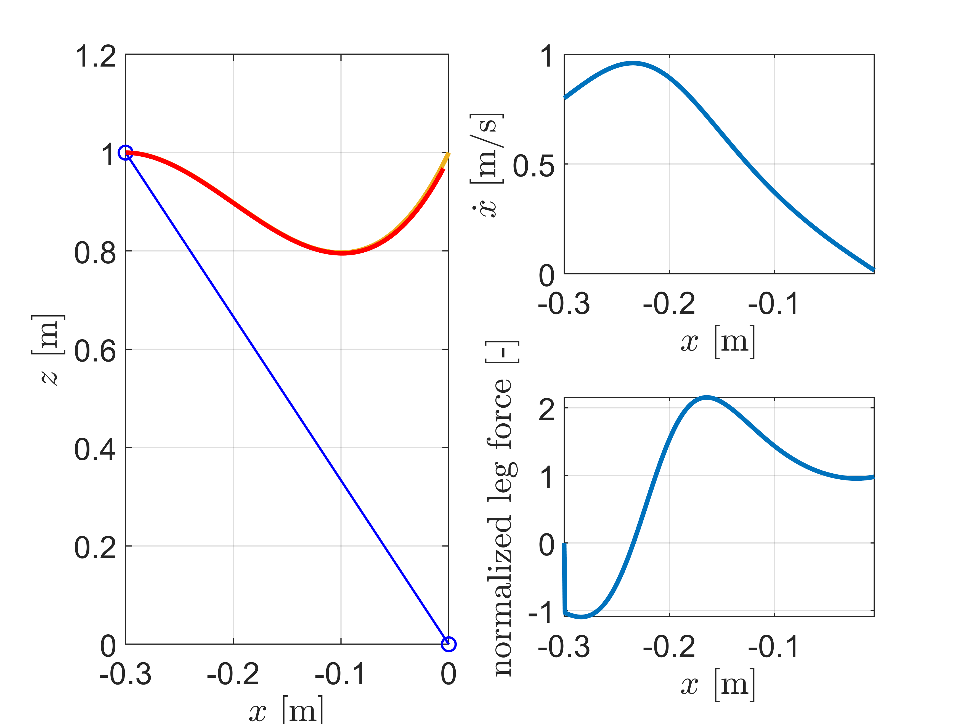
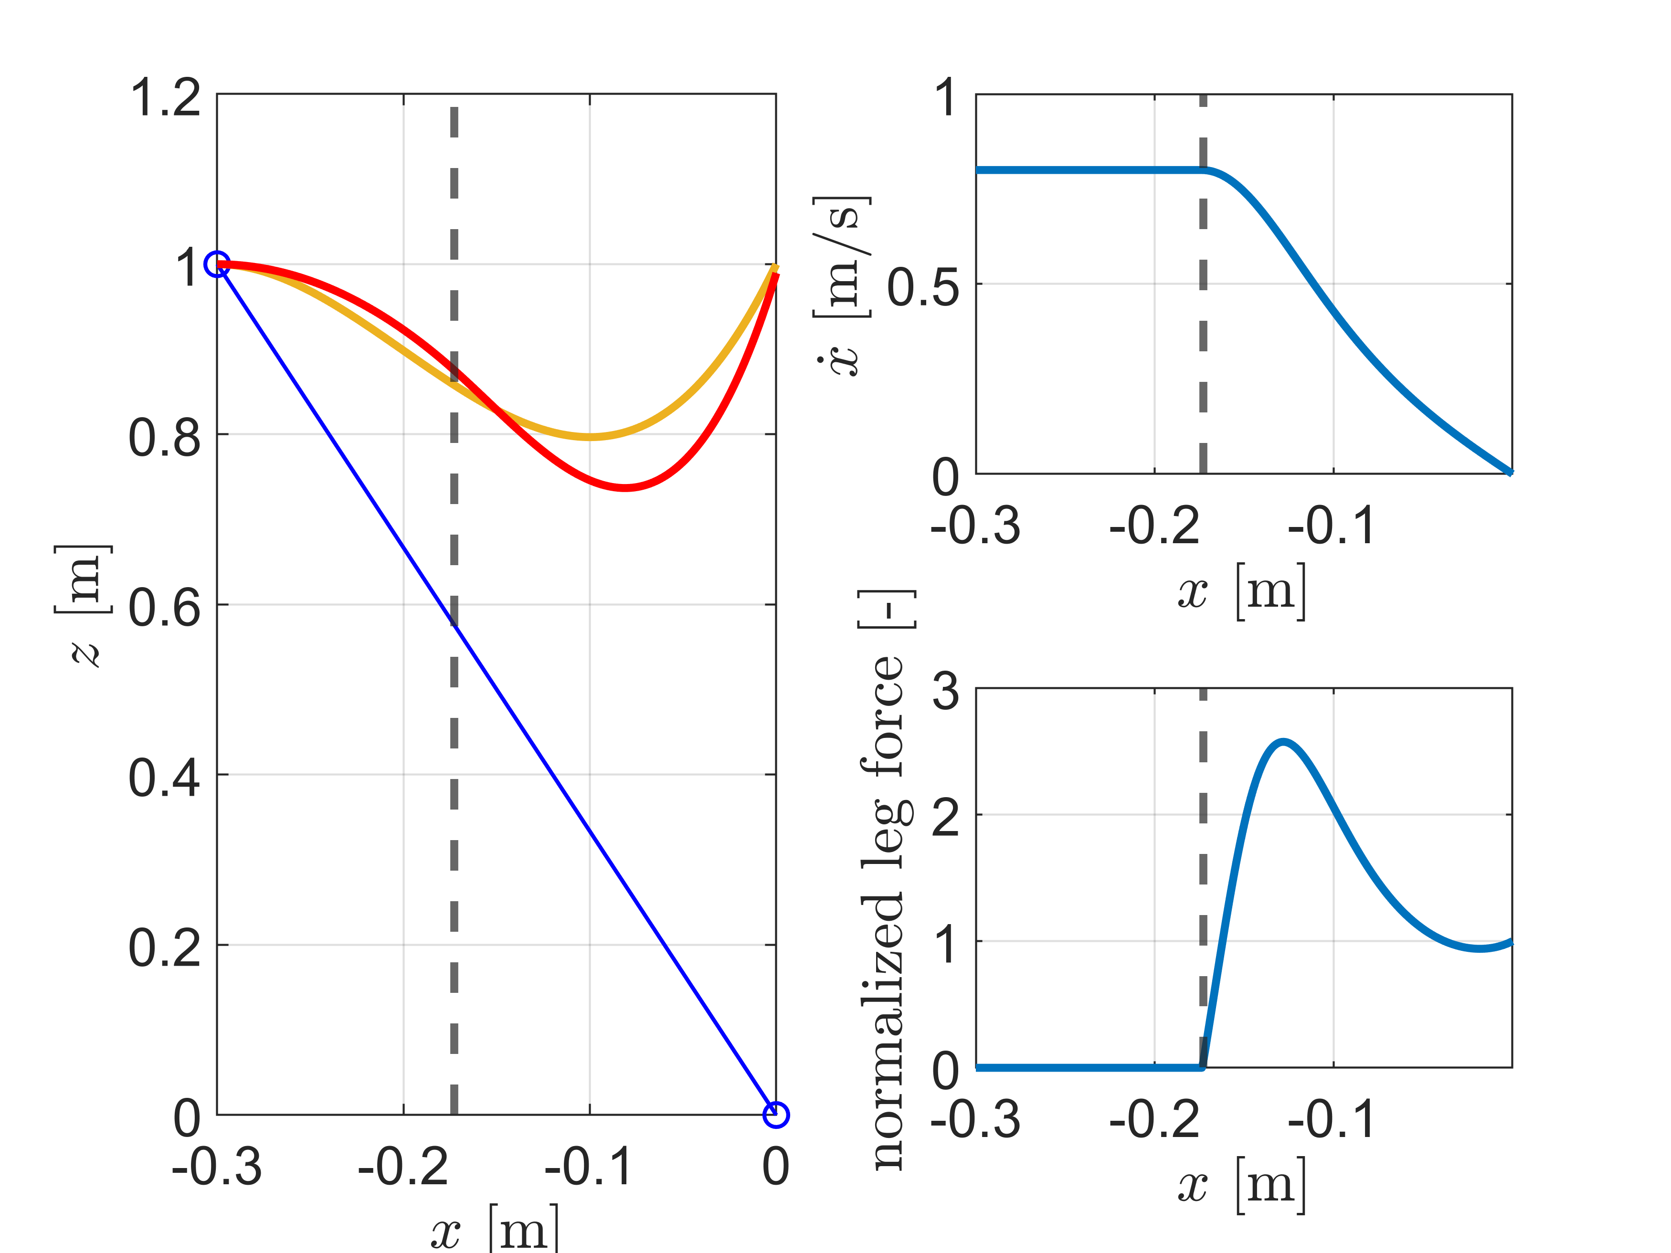
Clipped Variant Control
The orbital energy controller u can not pull on the ground.
11

Slide 13
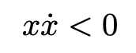
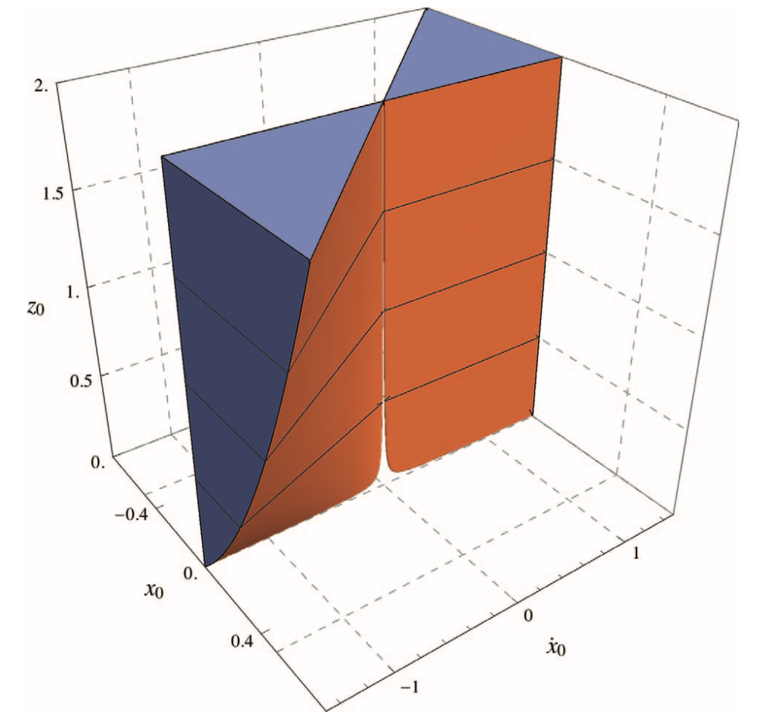
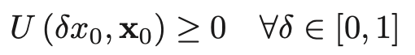
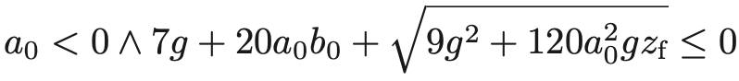
Region of attraction
Unilateral control u ≧ 0.
Considering a first-order formula, i.e. an expression written combining a set of polynomial equations and inequalities (in variables y₁,…y_{n}) using the logical conjuction (⋀), disjuction (⋁), and negation (¬) operators, we obtained:
12

Slide 14
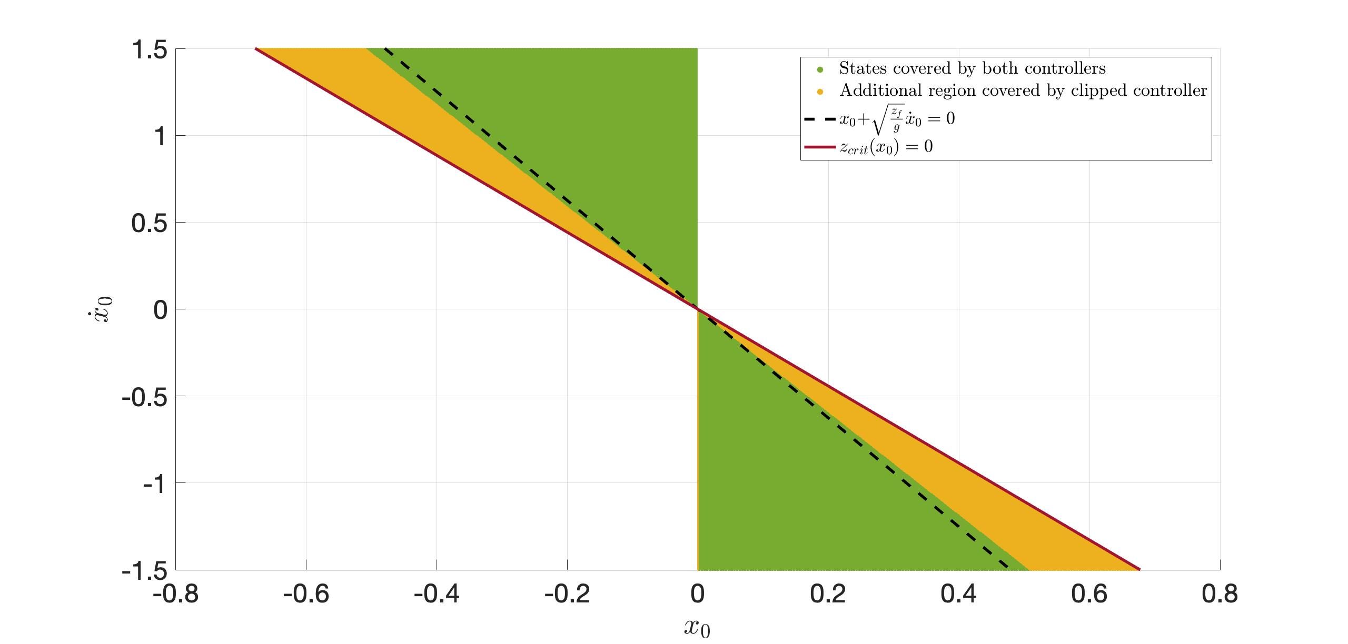
Region of attraction
13

Slide 15
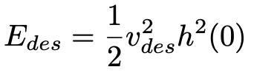
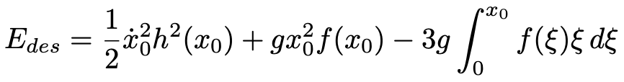
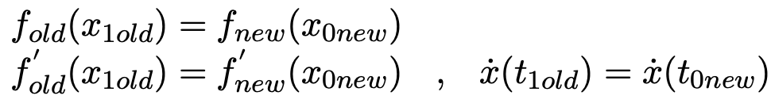
Velocity Control
Let v_{des} be the desired velocity at the top of the next stride (when x = 0), then:
Equating these two expressions, and solving for x₀, we get the location to step in order to achieve the desired v_{des}
It is important to have a smooth connection between consecutive functions f(x) at each step, so:
14

Slide 16
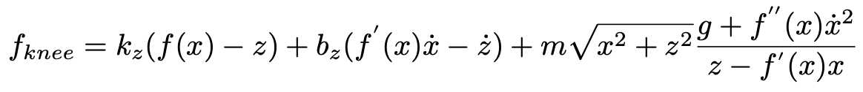
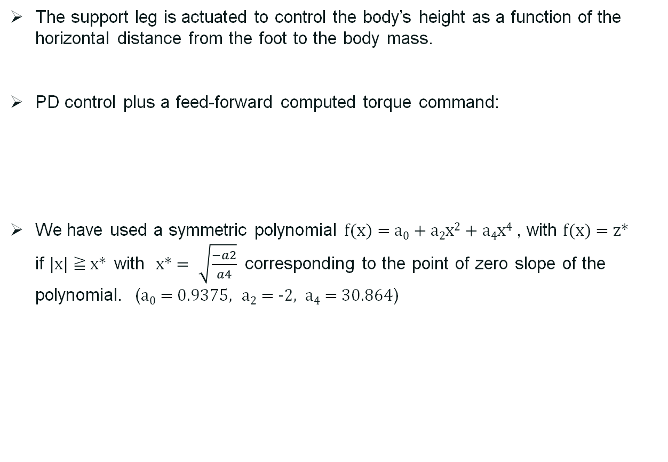
Simulation settings
The support leg is actuated to control the body’s height as a function of the horizontal distance from the foot to the body mass.
PD control plus a feed-forward computed torque command:
We have used a symmetric polynomial f(x) = a₀ + a₂x² + a₄x⁴ , with f(x) = z* if |x| ≧ x* with x* = $\sqrt{\frac{−a2}{a4}}$ corresponding to the point of zero slope of the polynomial. (a₀ = 0.9375, a₂ = -2, a₄ = 30.864)
15

Slide 17
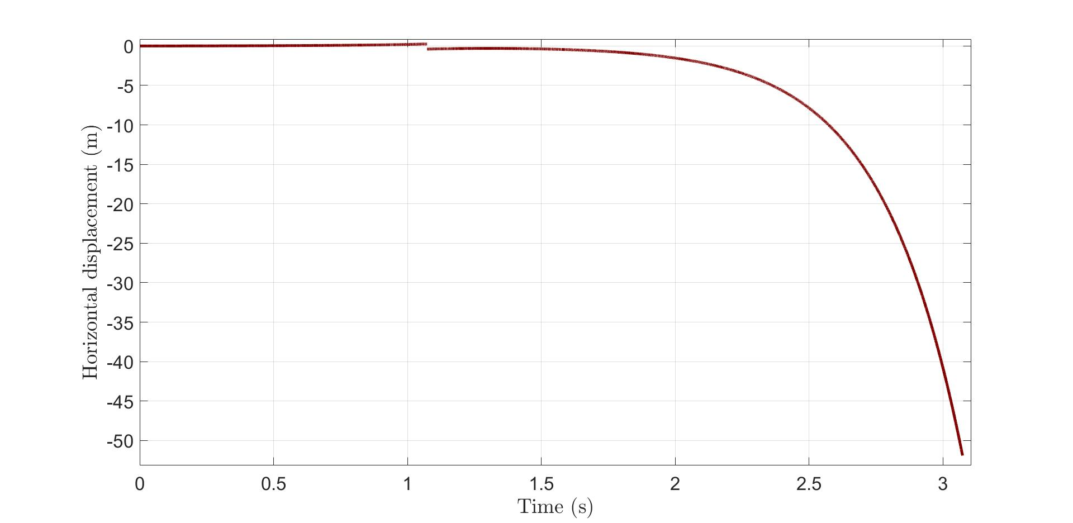

Multiple choices for x₀
Since the previous equation relative to E_{des} has multiple solutions w.r.t. x₀ if we choose a step sufficiently large considering a starting $\dot{\text{x}\text{0}}$, the robot can’t do it. So it falls down!
16

Slide 18
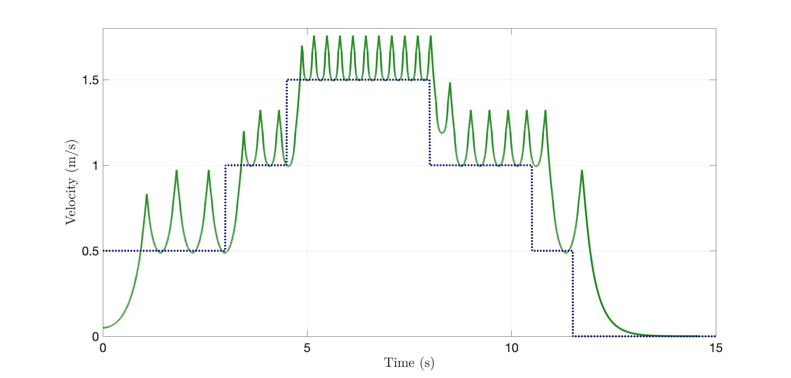
Simulation with variable v_{des}
17

Slide 19
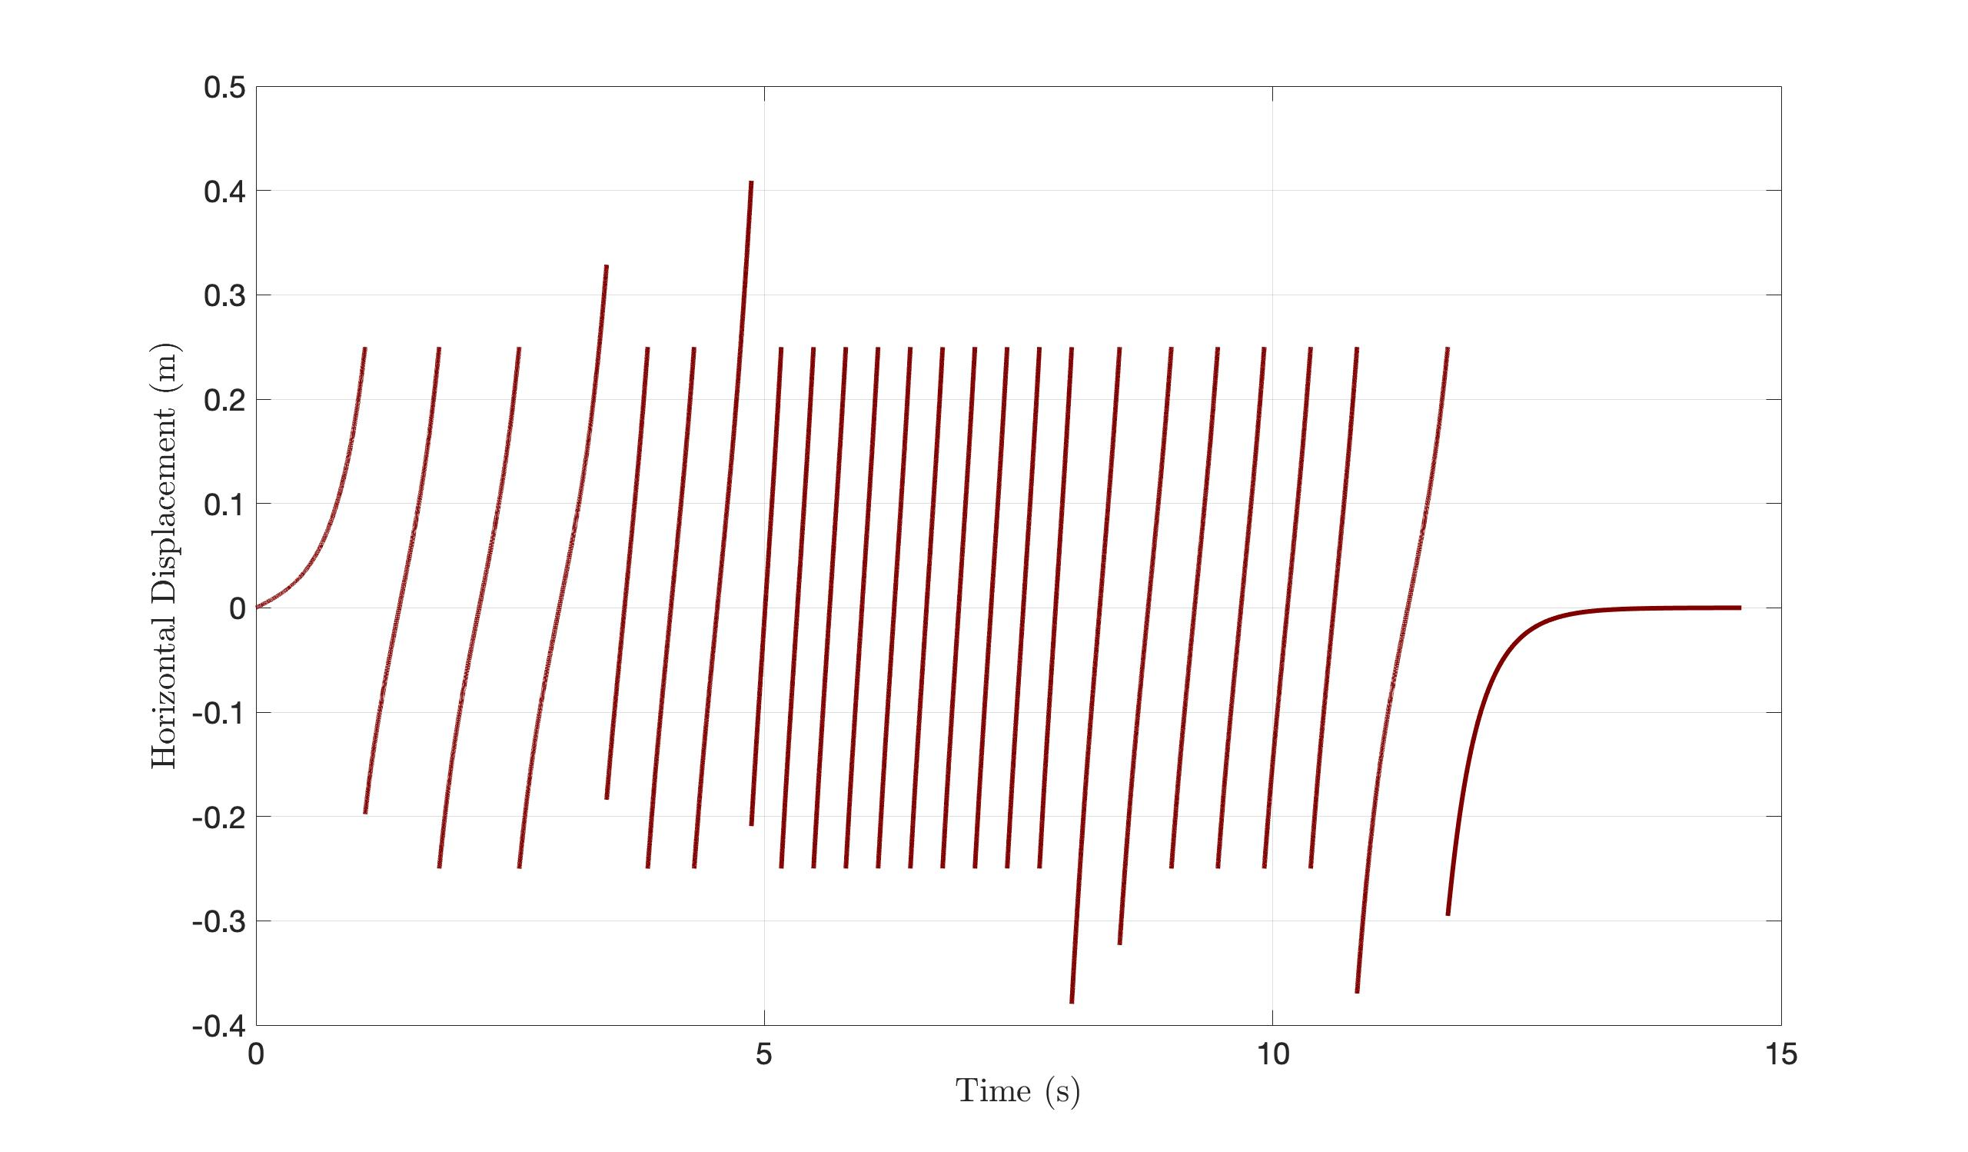
Simulation with variable v_{des}
18

Slide 20
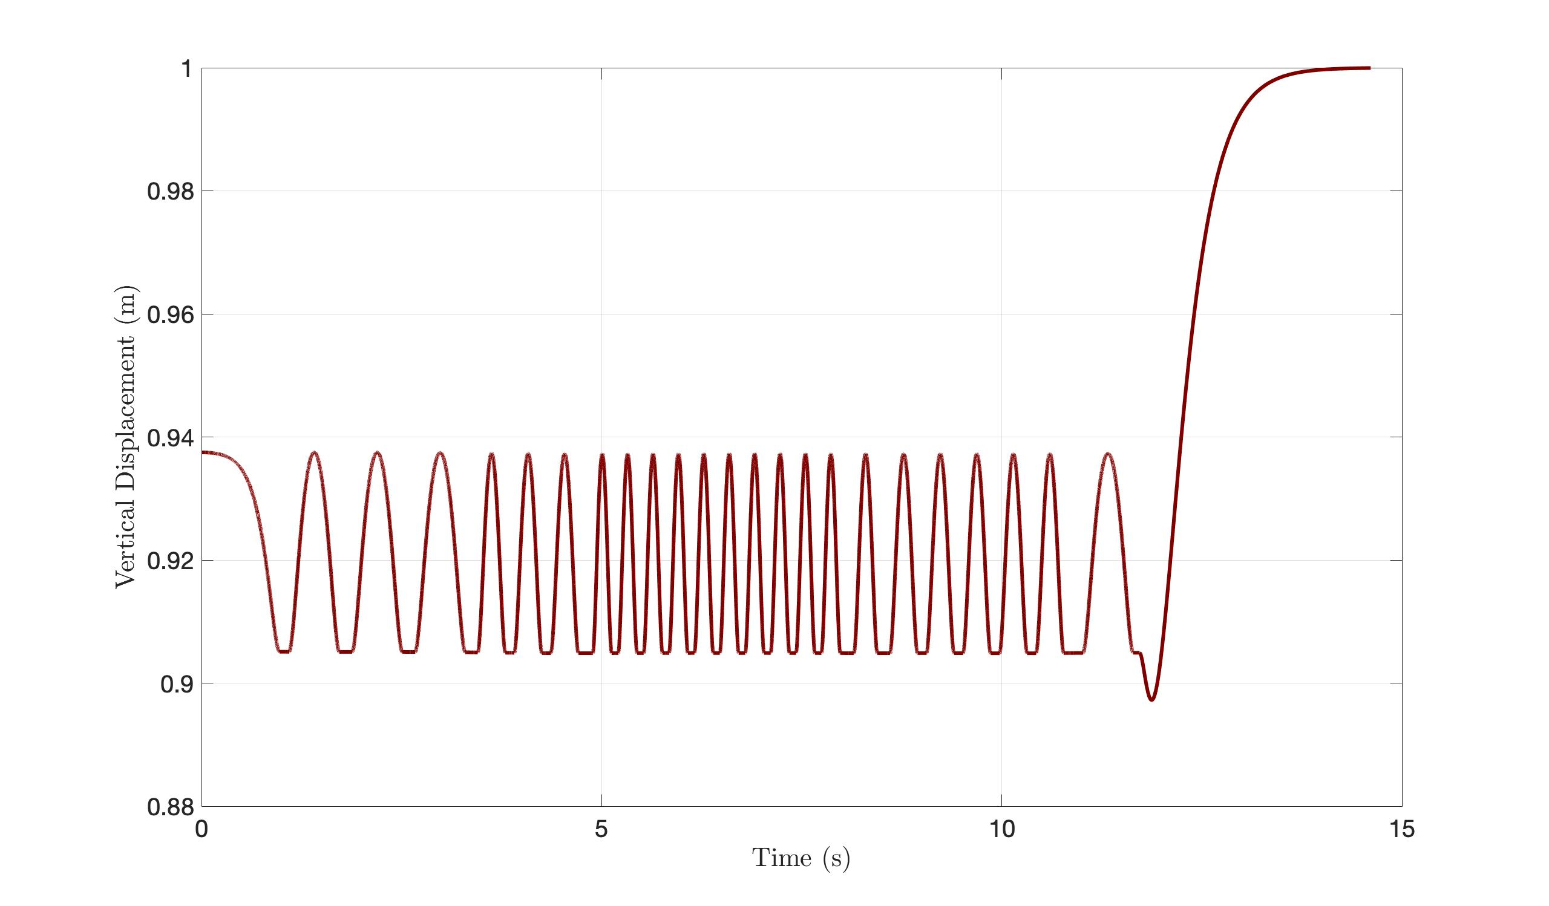
Simulation with variable v_{des}
19

Slide 21
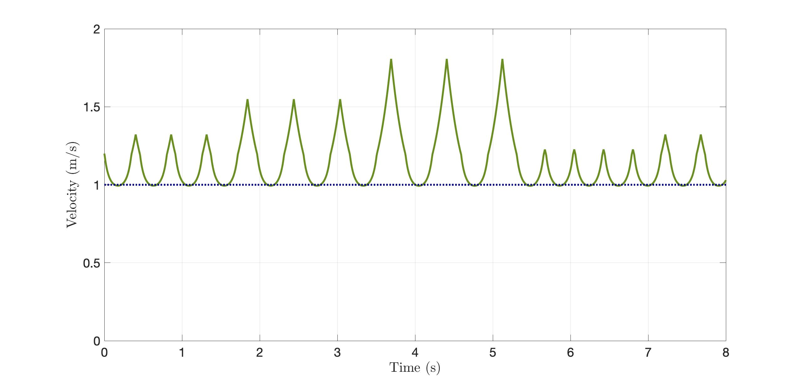
Simulation with variable step size
20

Slide 22
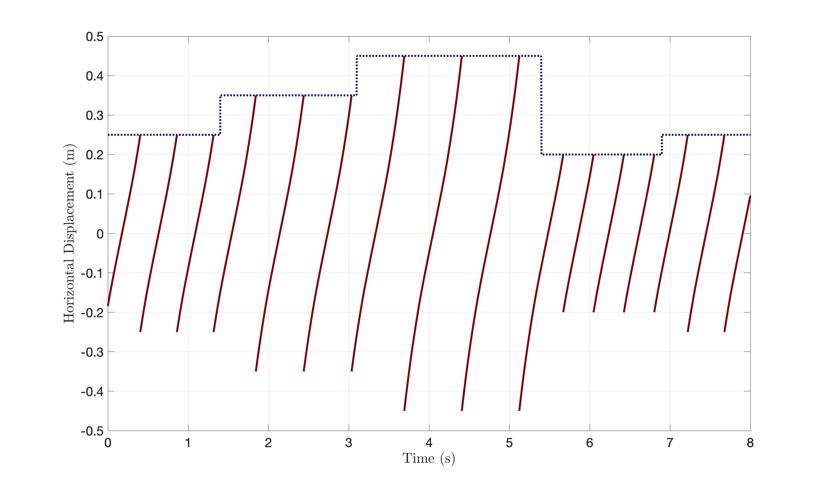
Simulation with variable step size
21

Slide 23
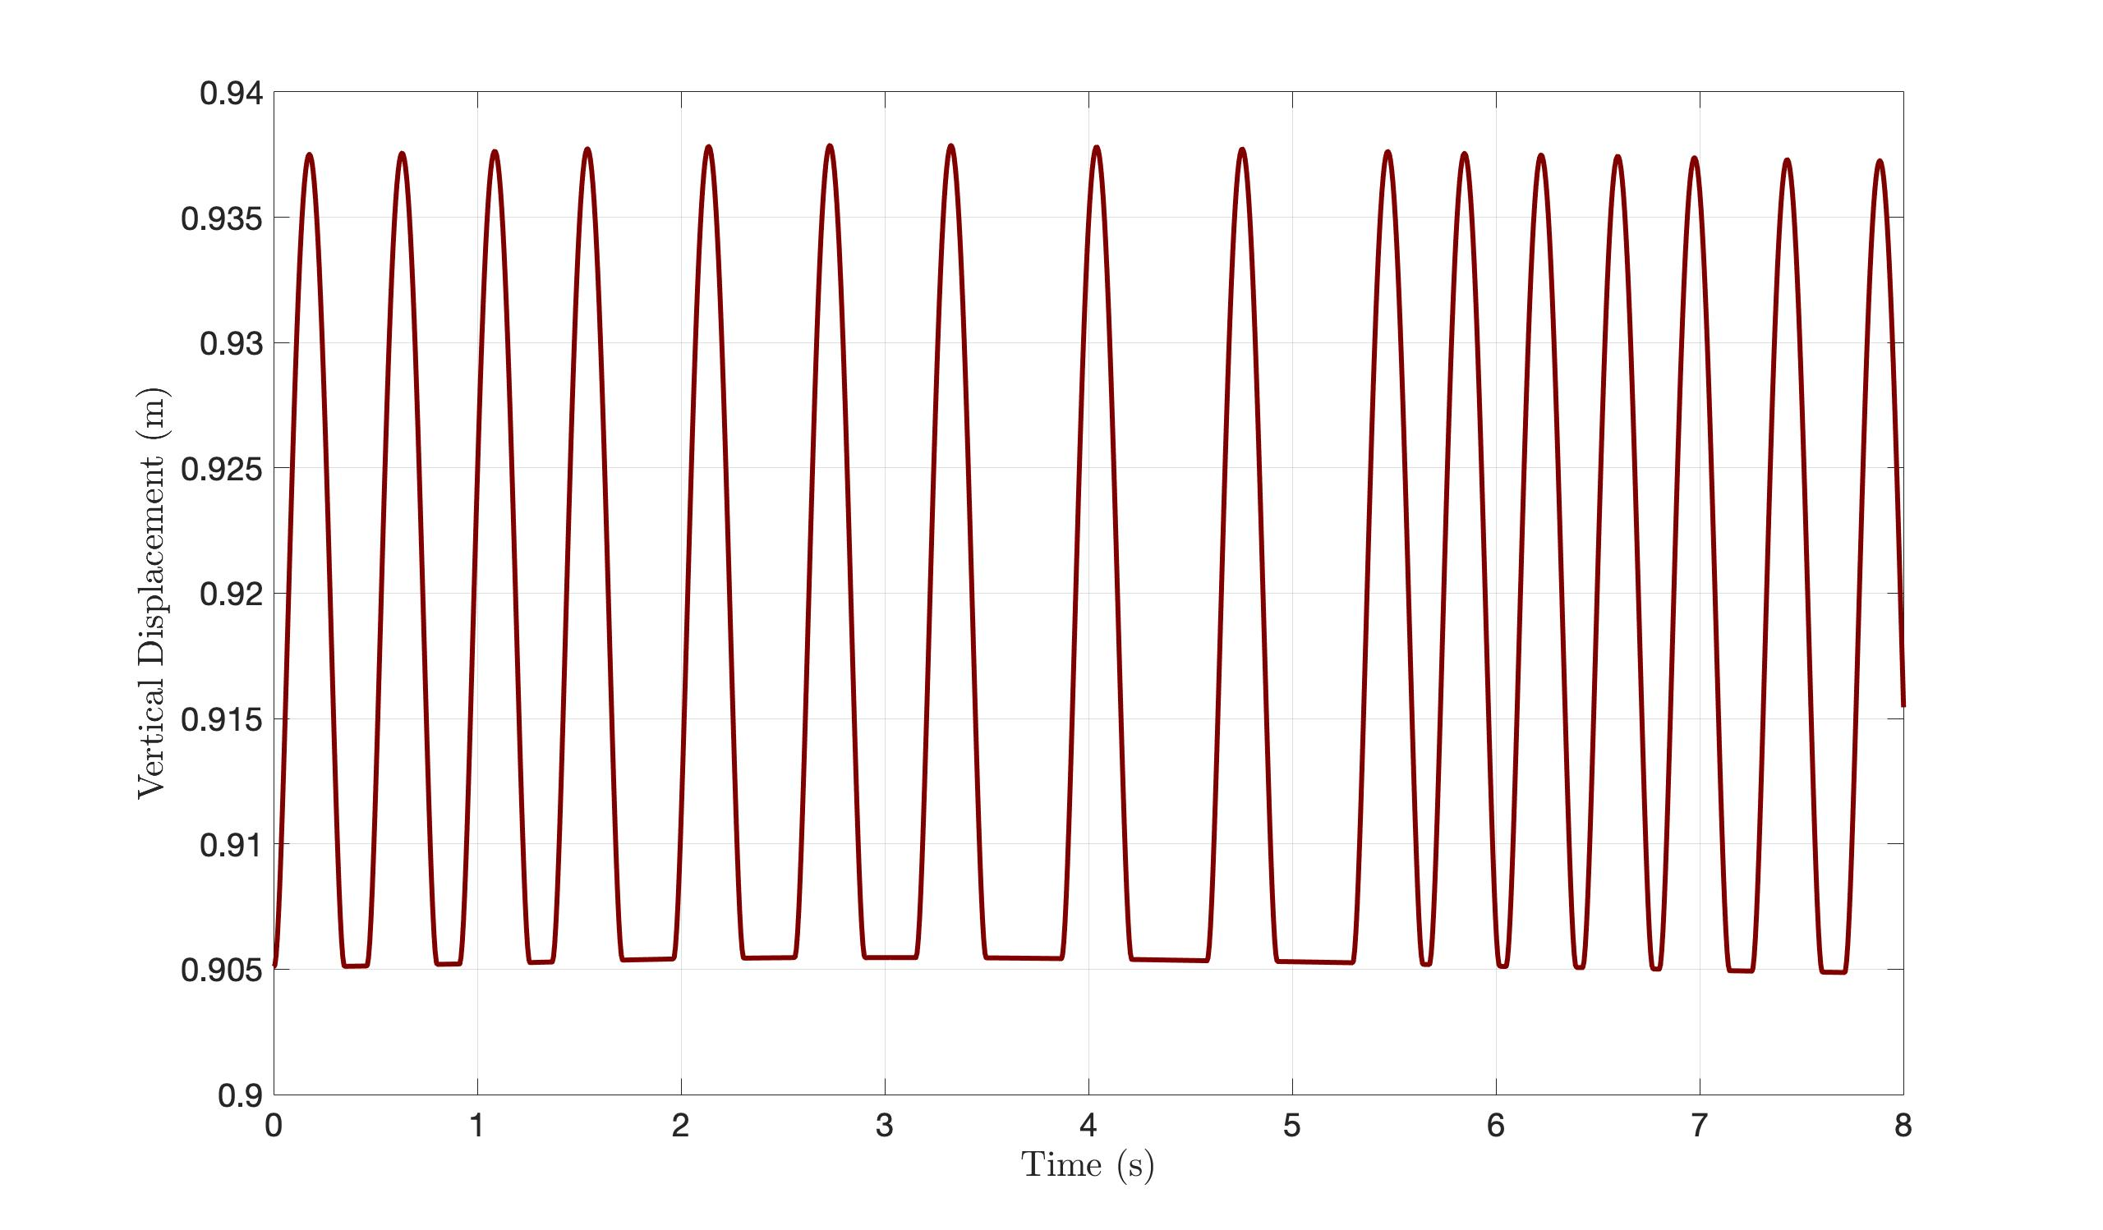
Simulation with variable step size
22

Slide 24
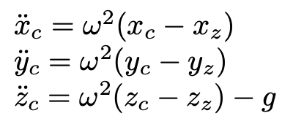
MPC for variable CoM height
The key idea is to control the robot through the definition of two relevant trajectories.
The goal is to develop a trajectory for the zmp which guarantees a balance condition.
It is imposed a virtual vertical dynamic such that the resultant dynamic is a 3D LIP.
23

Slide 25
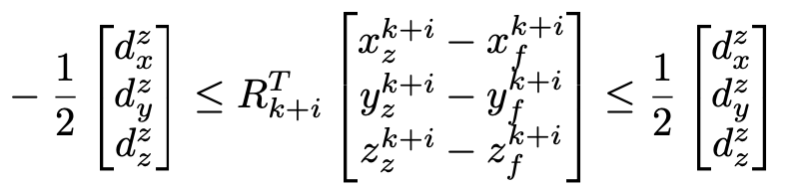
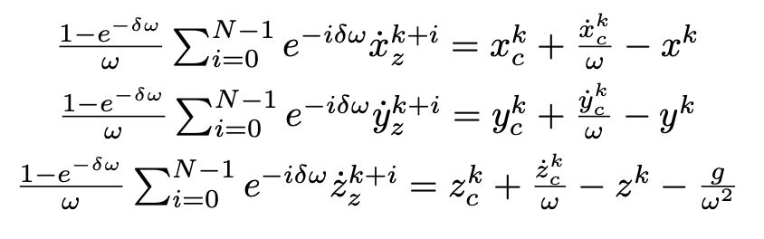
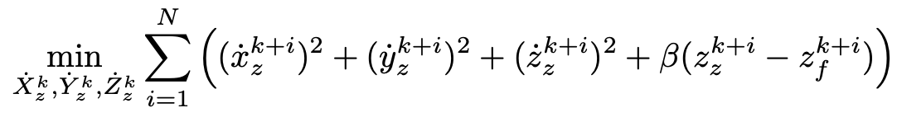
MPC for variable CoM height
ZMP constraints:
Stability constraints considering
anticipative tails:
24

Slide 26
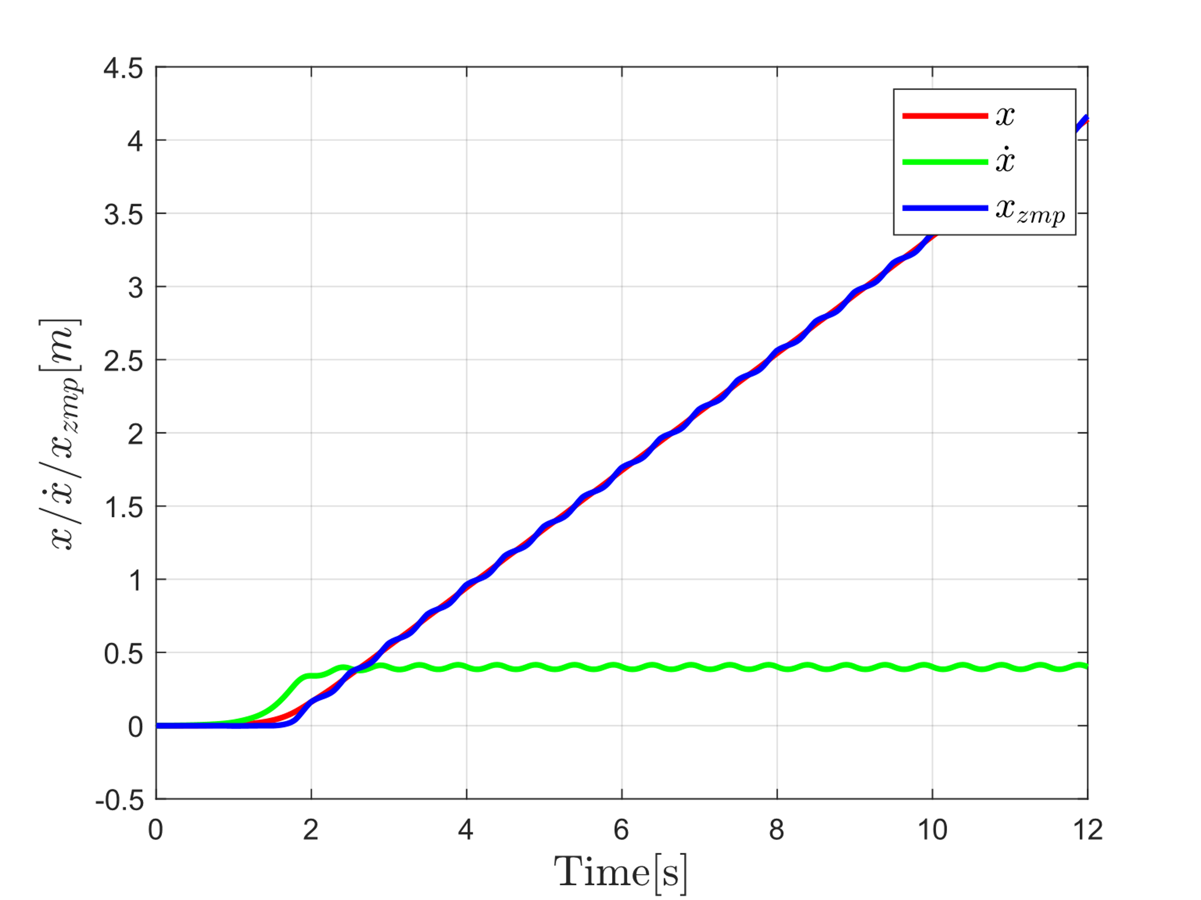


Simulation results
25

Slide 27


Simulation results
26

Slide 28
Conclusions
MPC
Orbital energy
Computationally more intensive
Stability issues tackled directly
Lack of prediction
Limitation of the point-foot assumption
Possibility of imposing directly the CoM trajectory
27

Slide 29
Thank you for the attention!
Leonardo Salustri (M1762556)
Paolo Sebeto (M1894763)
Francesco Scotti (M1758391)

